Slide 1
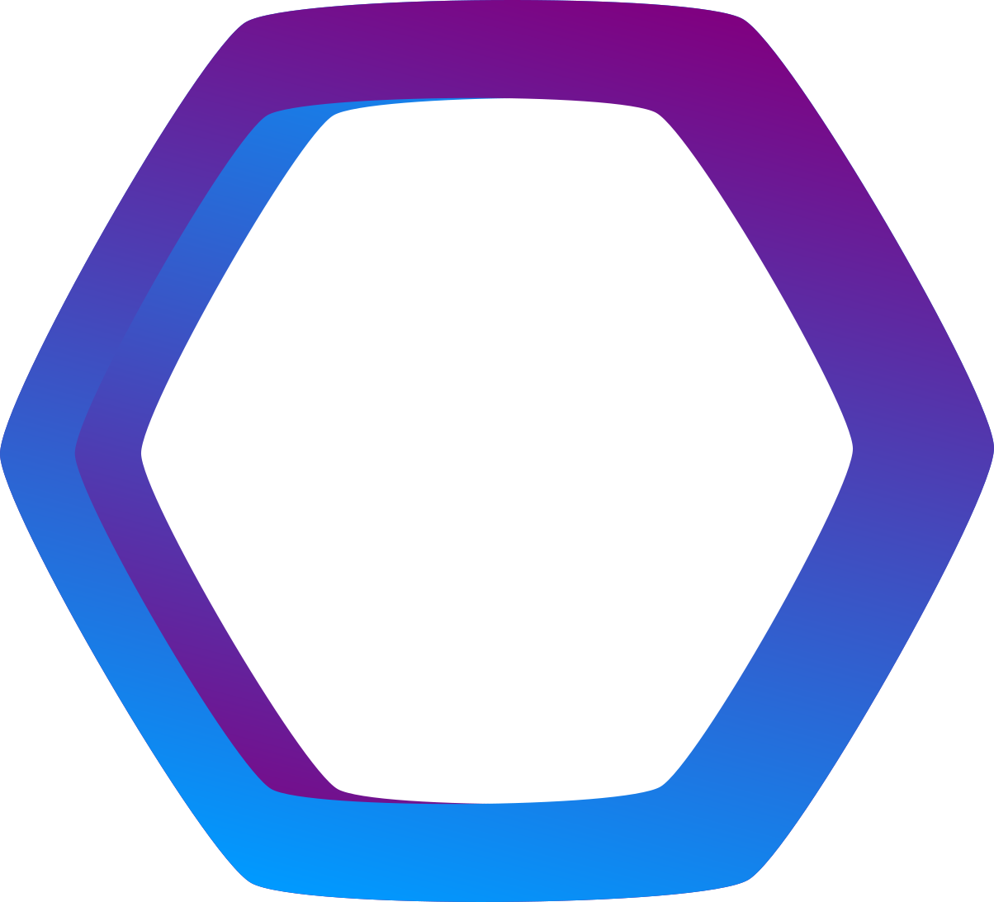
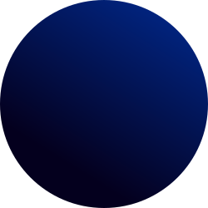

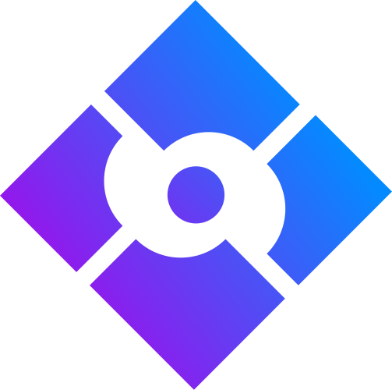
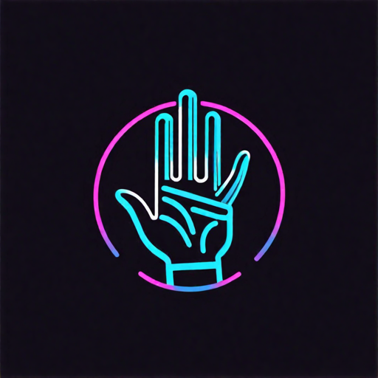
CS106
Basic Machine Learning
HAND GESTURE
RECOGNITION
Presented by: Ujjwal Kakar (23/CS/443)
Utkarsh Chaudary (23/CS/445)
Vishrut Grover (23/CS/462)
Ananya Gupta (23/CS/486)
Aryan Pundir (23/CS/520)

Slide 2

Overview
Introduction
Objectives
Methodology
Mediapipe over CNNs?
Model Architecture
Tech Stack
Future Prospects
Code Snippets
Bibliography
Our Team

Slide 3
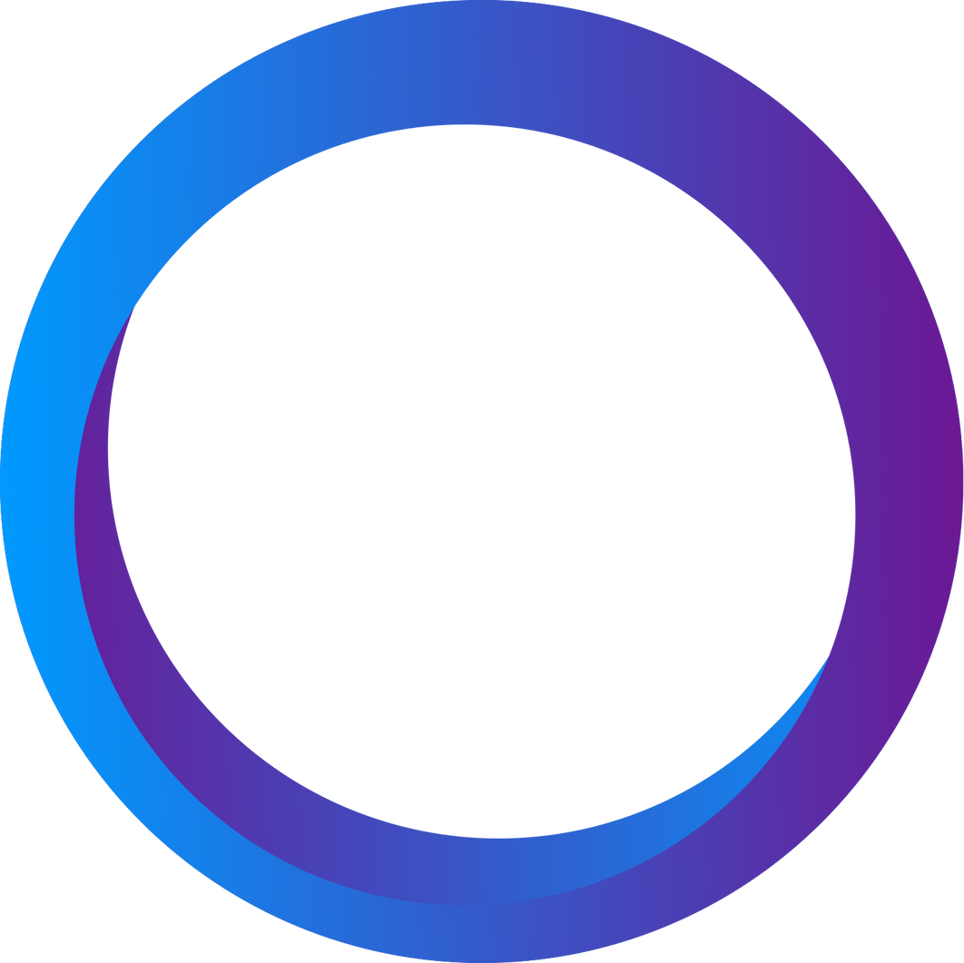
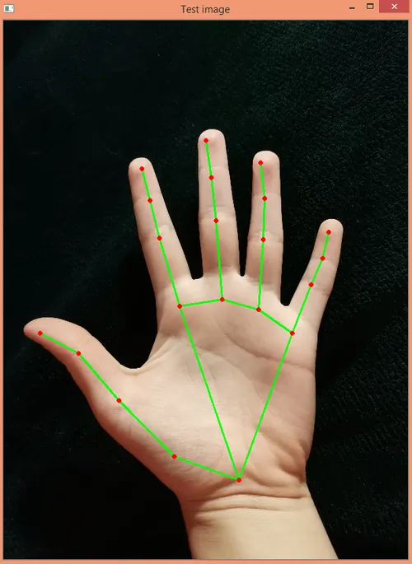
Introduction
Aviation industry has been dependent on Autonomous Vehicles like UAVs heavily in the previous few years.
Various methods of drone control have been implemented like radio, remote, mobile applications etc.
In this project, we try to implement a hand orientation/gesture recognition system that could be used to maneuver a Tello Drone.

Slide 4
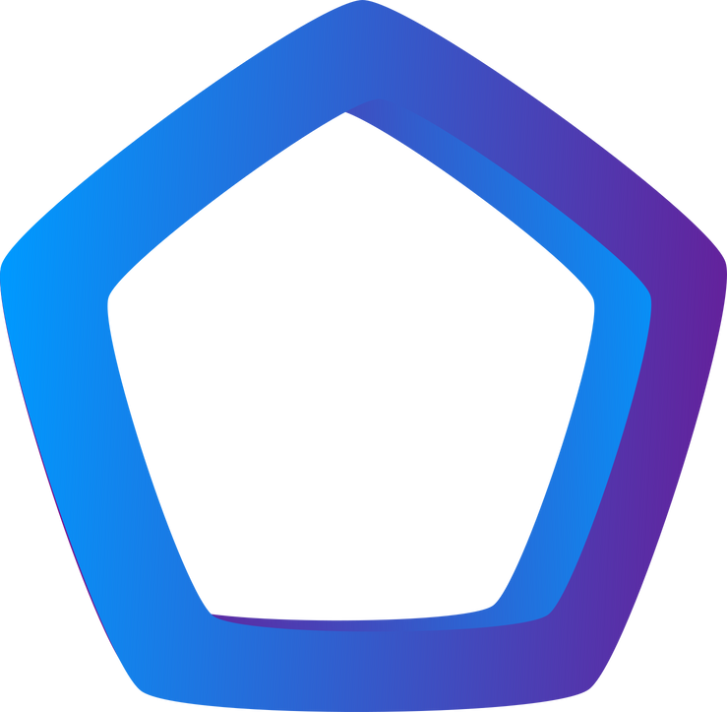
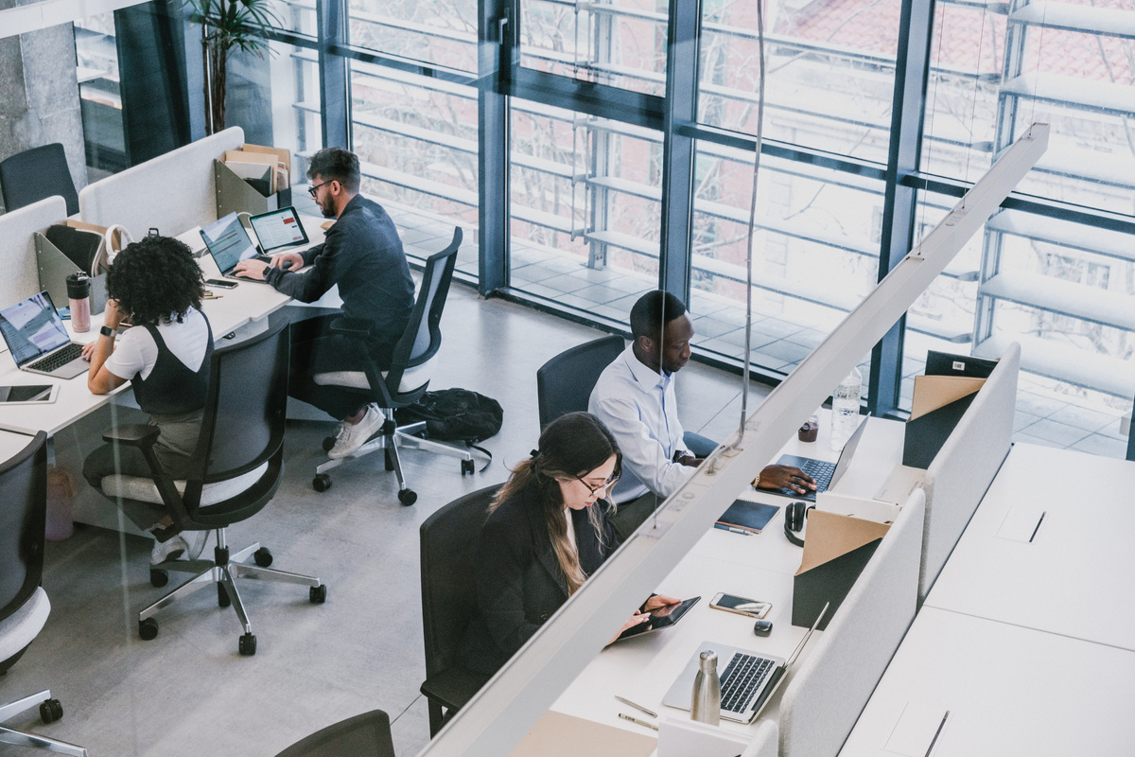
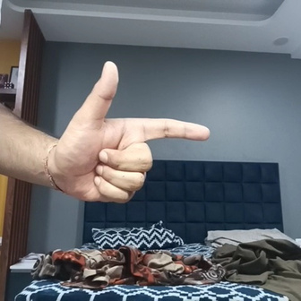
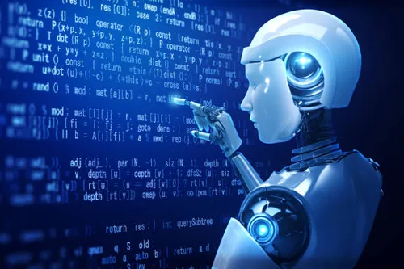
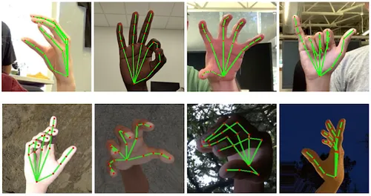
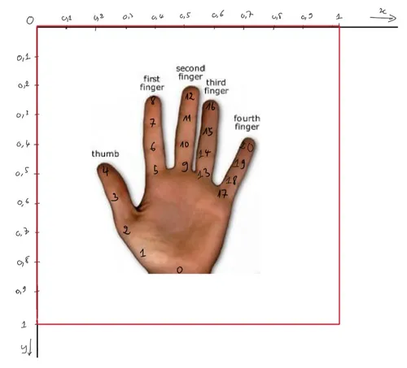
Objectives
Making the complete dataset from scratch by capturing pictures from our webcam.
Develop an end-to-end machine learning model for recognizing hand gestures.
Incorporating Mediapipe library for dynamic and real time interpretation of hand gestures.
Explore alternate measures and conduct a comparative study to see why Mediapipe gives the best results.

Slide 5






Methodology
01
02
03
04
Data Acquisition: Creating the dataset by capturing the images from our webcam.
Data Preprocessing: Getting the 21 hand landmarks from each image and storing it in a dataframe.
Model Compilation: Inputting the data in our neural networks made using Sequential and Dense.
Live
Working: Inputting the data in our neural networks made using Sequential and Dense.

Slide 6
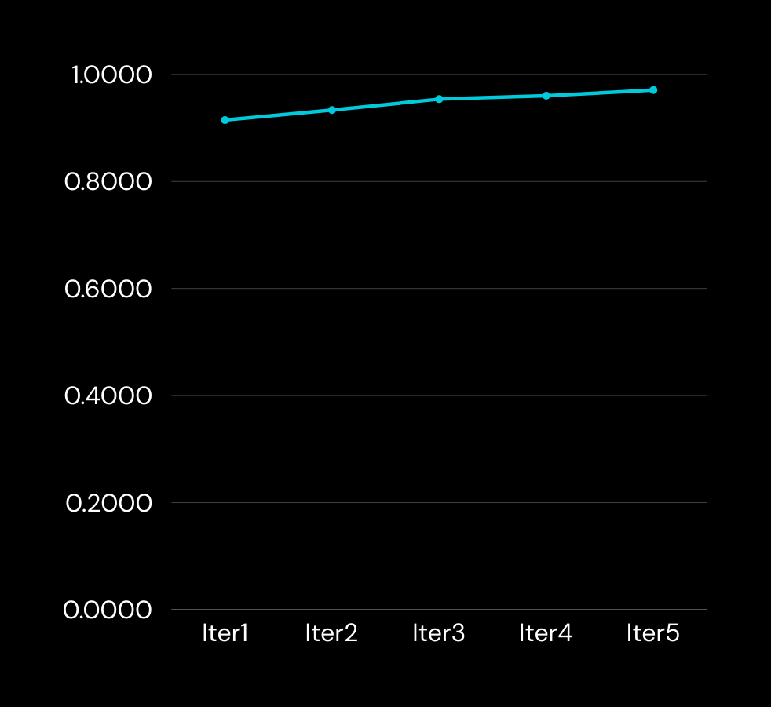
Why did we choose Mediapipe over CNNs?
Lets see how well Mediapipe performs
CNNs might generalize the background to be part of a certain gesture unless it is removed or the hand is segmented out, so we used mediapipe to reduce the load.
Mediapipe's optimized pipelines can run efficiently on resource-constrained devices, such as smartphones or embedded systems, without consuming excessive computational resources.
Mediapipe is optimized for real-time performance, making it ideal for applications where low latency is crucial.
97%
100%
0.47
Accucary curves (train)
Training Accuracy
Validation Accuracy
Validation Loss

Slide 7
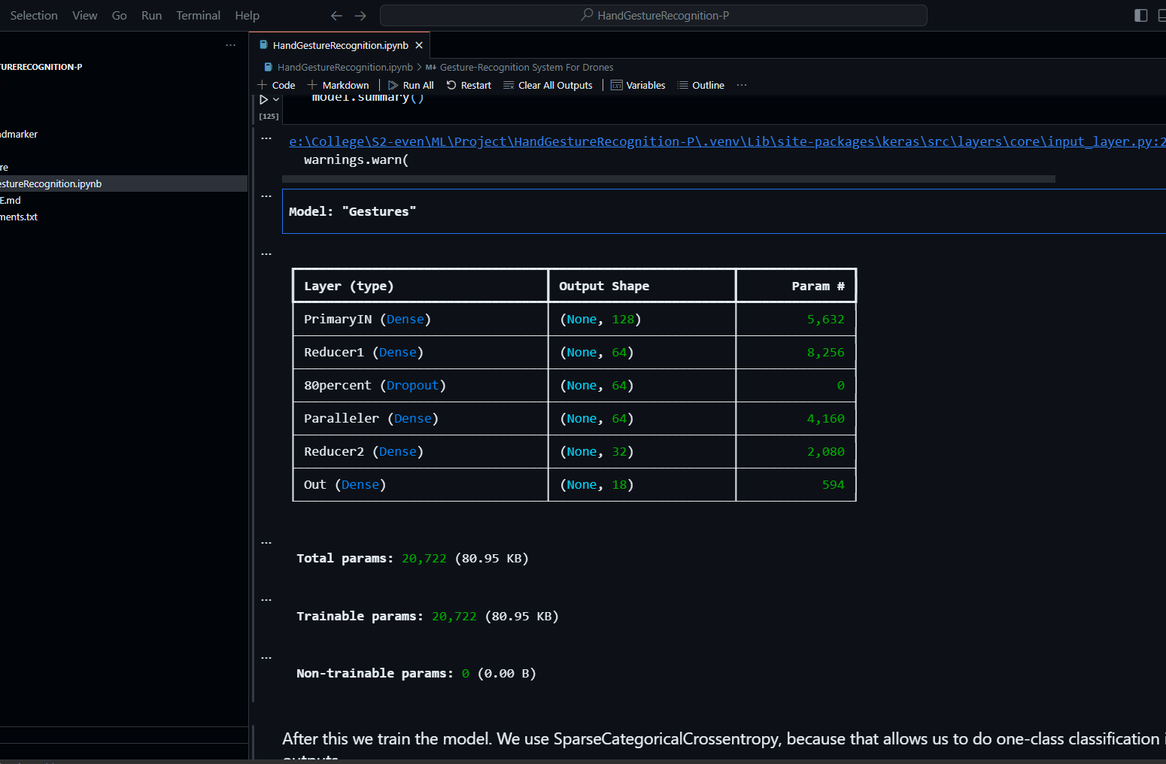
Model Architecture
Input Layer: Accepts input with 43 features.
Dense Layer (PrimaryIN): Consists of 128 neurons with ReLU activation and L2 regularization.
Dense Layer (Reducer1): Contains 64 neurons with ReLU activation and L2 regularization.
Dropout Layer: Regularizes the network by randomly setting 20% of the input units to 0.
Dense Layer (Paralleler): Consists of 64 neurons with ReLU activation.
Dense Layer (Reducer2): Contains 32 neurons with ReLU activation.
Dense Layer (Out): Final output layer with 18 neurons and linear activation.
Overall, this architecture comprises two sets of dense layers with dropout regularization, aiming to learn patterns from the input data and produce an output with 18 units.

Slide 8
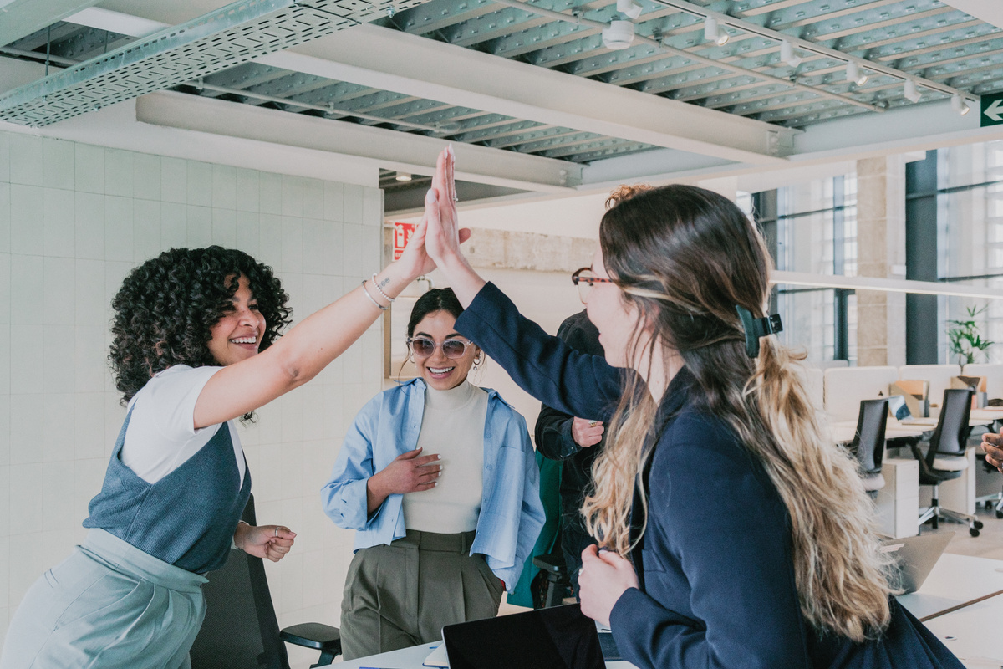
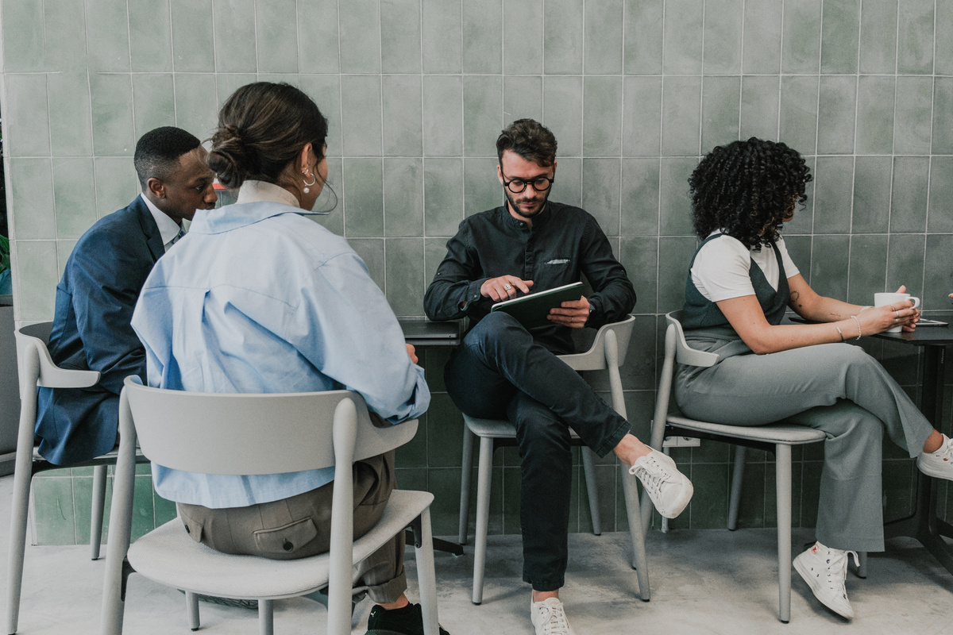
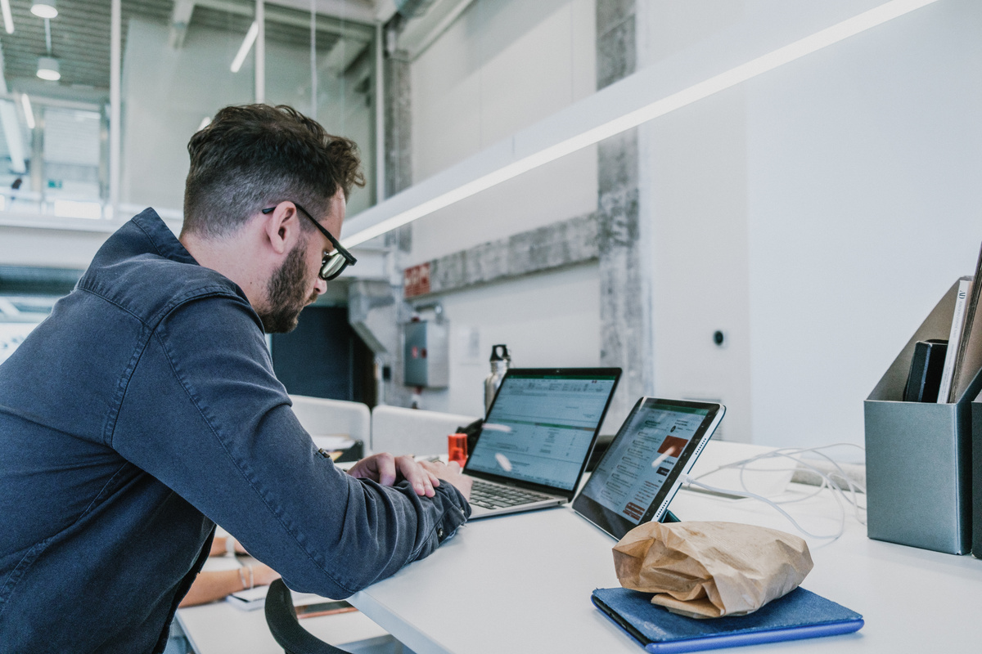
Tech Stack
Numpy, Pandas
Tensorflow
Mediapipe
OpenCV
NumPy is a library for numerical computations in Python, offering arrays, linear algebra, and mathematical functions. Pandas provides data manipulation tools like data frames, enabling easy data analysis.
TensorFlow is an open-source machine learning framework by Google, offering tools for building and deploying deep learning models, with support for neural networks and numerical computations.
MediaPipe, by Google, is a framework for real-time perception tasks like hand tracking, pose estimation, and facial recognition using machine learning.
OpenCV, Open Source Computer Vision Library, provides tools for real-time computer vision and machine learning, encompassing image and video processing, and feature extraction tasks in various programming languages.

Slide 9
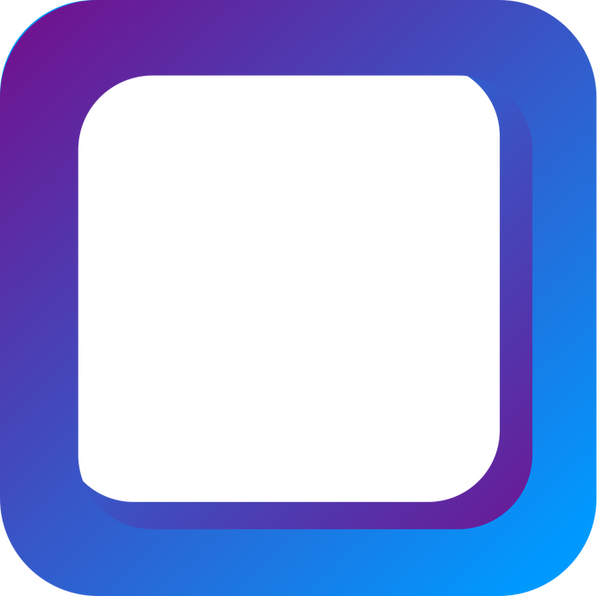



Future Prospects
Simulating flight in Gazebo/ROS
Gazebo provides a realistic 3D environment, while ROS enables communication and control. Integration into the UAV's control loop ensures real-time responsiveness. Feedback from the simulated environment ensures accurate execution of commands.
Implementation on an actual Tello drone
Develop a hand gesture recognition model using CNN or RNN. Train it with a dataset of gestures mapped to Tello drone commands. Integrate the model with the Tello SDK for control. Test for accuracy and responsiveness. Refine for optimal performance. Consider future applications like gesture-based navigation in drones or other devices.
Hosting a live demo on a web app/ mobile app
Users can interact with the drone via webcam on the app, observing their gestures translating into drone commands. Collect user feedback to refine the model and enhance user experience.

Slide 10
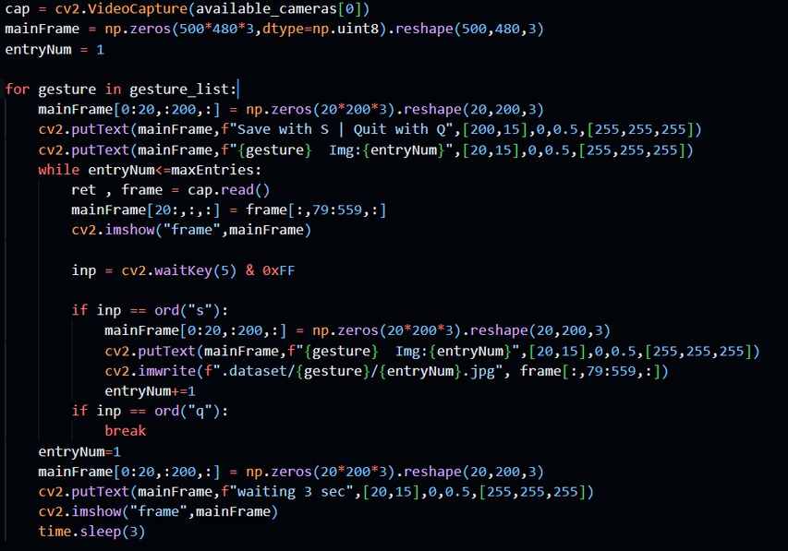
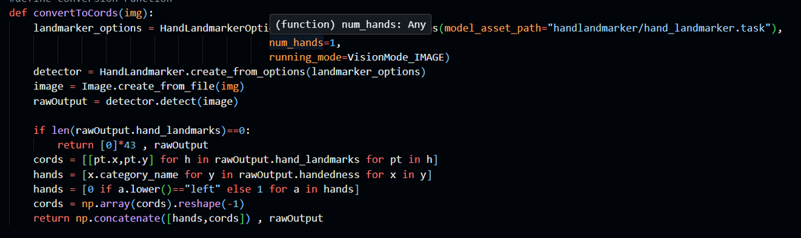
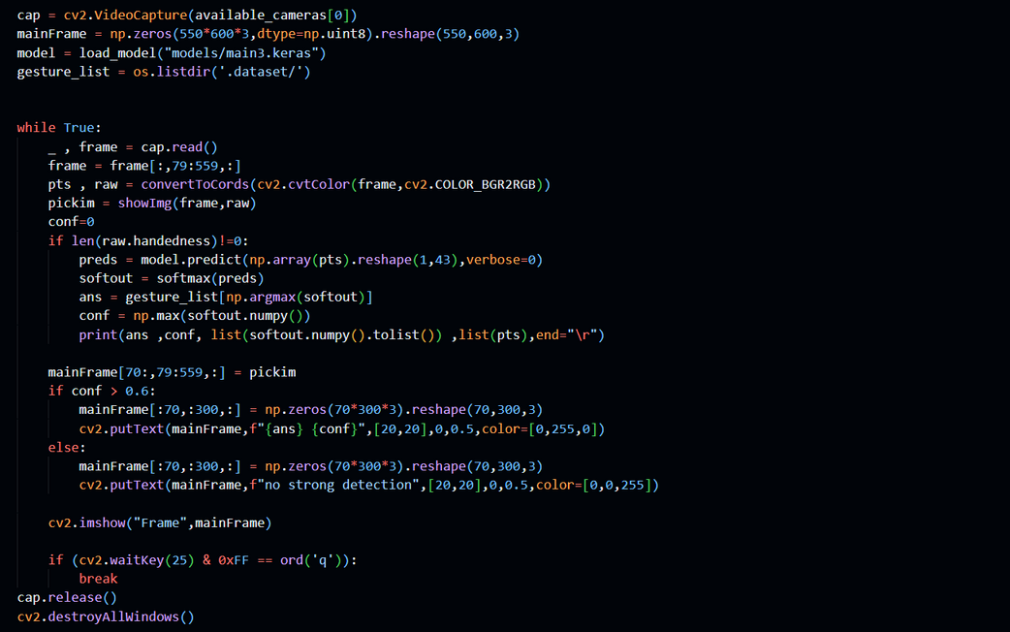
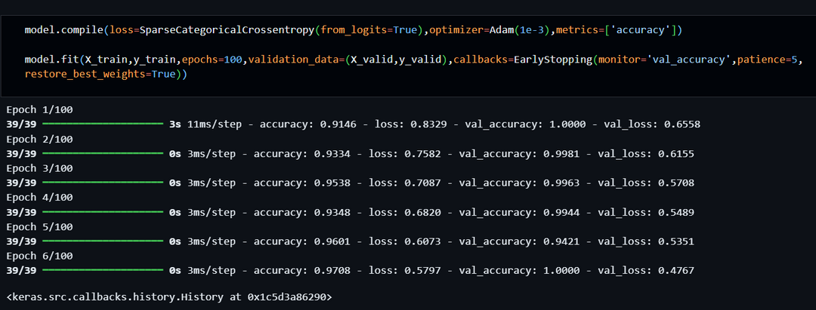
Code Snippets

Slide 11
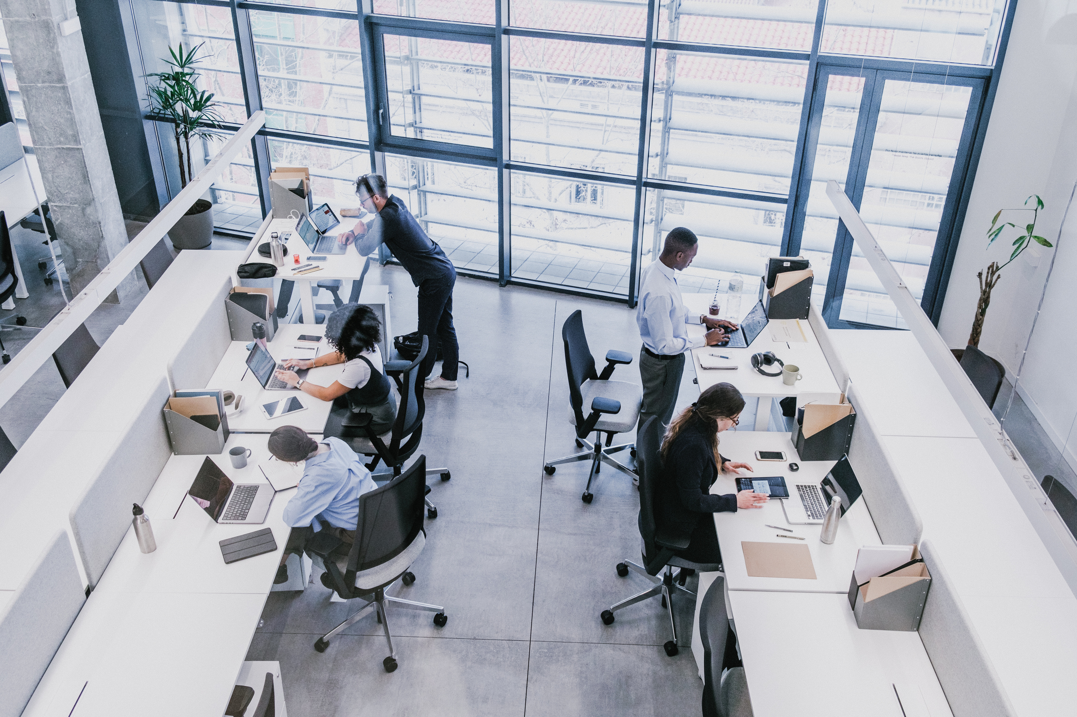
Bibliography
https://developers.google.com/mediapipe/solutions
https://docs.opencv.org/4.x/index.html
https://numpy.org/doc/stable/user/index.html#user
https://pandas.pydata.org/docs/user_guide/index.html#user-guide
https://www.tensorflow.org/api_docs/python/tf/keras

Slide 12
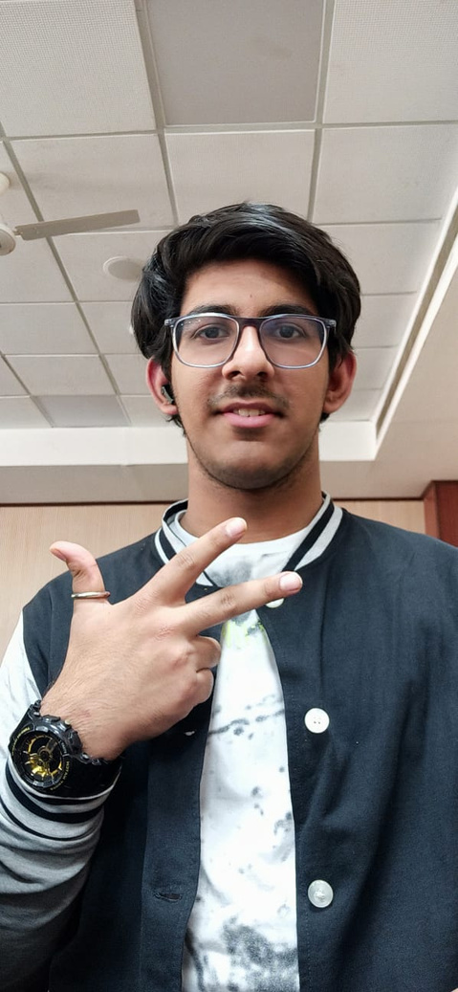
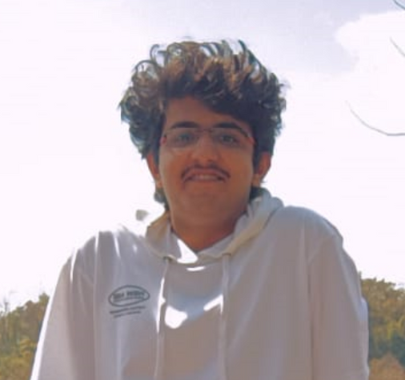
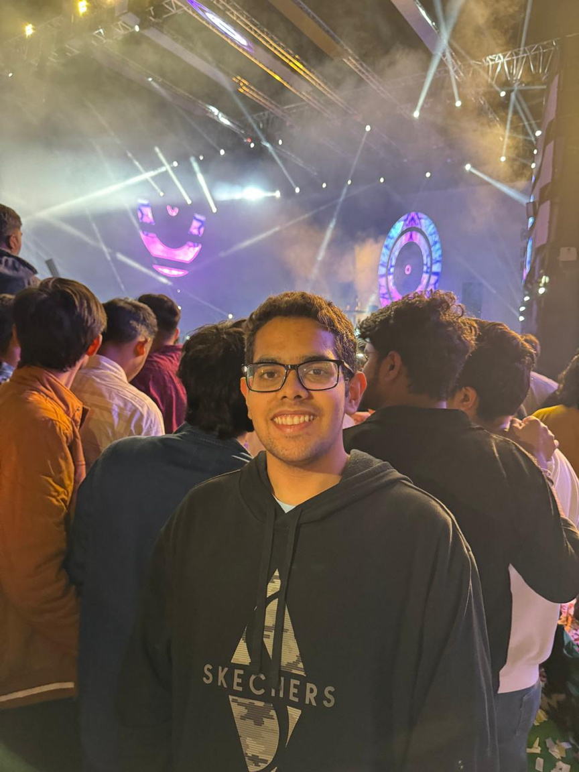
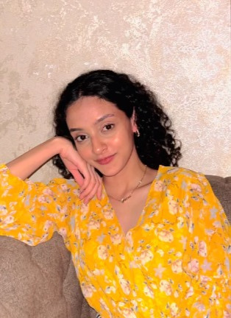
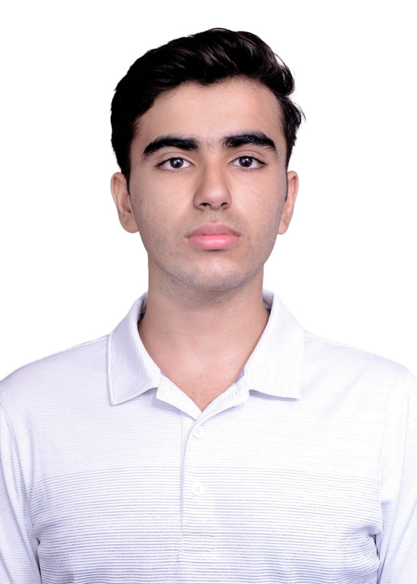
Our team
Ujjwal Kakar
Utkarsh Chaudhary
Vishrut Grover
Ananya Gupta
Aryan Pundir
23/CS/443
23/CS/445
23/CS/462
23/CS/486
23/CS/520
Gian
hai
aap

